Slide 1

Green Pace
Security Policy Presentation
Developer: Caleb Sorell

Slide 2

OVERVIEW: DEFENSE IN DEPTH
Primary Goal: Transition Green Pace to a DevSecOps environment to prepare for our upcoming security audit.
Core Strategy: Implement a comprehensive “Defense in Depth” architecture.
Implementation: Layer security continuously from the physical network perimeter down into the application code, ensuring redundant protections.

Slide 3
THREATS MATRIX
Likely Catching Exceptions by Value (STD-007): High Likelihood + Medium Severity. It is very common for developers to make this minor syntax error, resulting in the loss of valuable logging data. | Priority SQL Injections (STD-004): High Likelihood + Critical Severity. These are actively targeted by attackers and result in catastrophic database loss. This is our absolute highest priority for automation.
Low priority Assertions with Side Effects (STD-006): Low Likelihood + Medium Severity. This is a rare logic error that usually just breaks local application state rather than exposing user data to hackers. | Unlikely Accessing Freed Memory (STD-005): Low Likelihood + Critical Severity. While a “Use-After-Free” attack is devastating, modern C++ practices make it highly unlikely to slip into production.

Slide 4
10 PRINCIPLES
Validate Input Data: Supported by STD-003 (Strings) and STD-004 (SQL Injections).
Heed Compiler Warnings: Supported by STD-001 (Type Conversions) and STD-008 (Uninitialized Variables).
Architect and Design for Security: Supported by STD-007 (Exceptions) and STD-009 (Race Conditions).
Keep it Simple: Supported by STD-006 (Assertions).
Default Deny: Supported by STD-010 (Error Logging – failing into a secure state).
Principle of Least Privilege: Supported by STD-005 (Strict Memory Protection).
Sanitize Data Sent to Other Systems: Supported by STD-004 (Parametrizing Database Queries).
Practice Defense in Depth: Supported by STD-002 (Integer Bounds) and STD-010 (Secondary Logging).
Use Effective QA Techniques: Supported by STD-008 and STD-009 (Enforced by automated CI/CD tools).
Adopt a Secure Coding Standard: Supported by full adherence to STD-001 through STD-010.

Slide 5
CODING STANDARDS
Priority 1 (Critical – Immediate Action Required):
STD-004: Neutralize SQL Injections
STD-005: Prevent Double-Free Memory Corruptions
Priority 2 (High-Fix Before Production):
STD-003: String Buffer Limits
STD-002: Integer Overflow/Underflow
STD-009: Avoid Race Conditions
STD-008: Initialize All Variables
STD-010: Prevent Sensitive Info Leaks
STD-001: Safe Type Conversions
Priority 3 (Medium – Technical Debt to Resolve):
STD-007: Catch Exceptions Securely
STD-006: No Side Effects in Assertions

Slide 6
ENCRYPTION POLICIES
Encryption in Flight: All network traffic must be encrypted using TLS 1.2 or higher. This protects data packets as they travel across the network from interceptors.
Encryption at Rest: All sensitive database records must be encrypted using AES-256. This ensures that even if the physical storage hardware is stolen, the data remains unreadable.
Encryption in Use: Sensitive computations must utilize secure enclaves or memory protection. This prevents unauthorized processes from reading sensitive data while it is being actively processed in system RAM.

Slide 7
TRIPLE-A POLICIES
Authentication (Identify Verification): Mandates Multi-Factor Authentication (MFA) for all user access to prevent unauthorized entry.
Authorization (Access Control): Implements Role-Based Access Control (RBAC) to enforce the “Principle of Least Privilege,” ensuring users access only the resources necessary for their job.
Accounting (Auditing & Logging): Requires immutable, tamper-evident logs for all system interactions to maintain a comprehensive forensic audit trail.

Slide 8
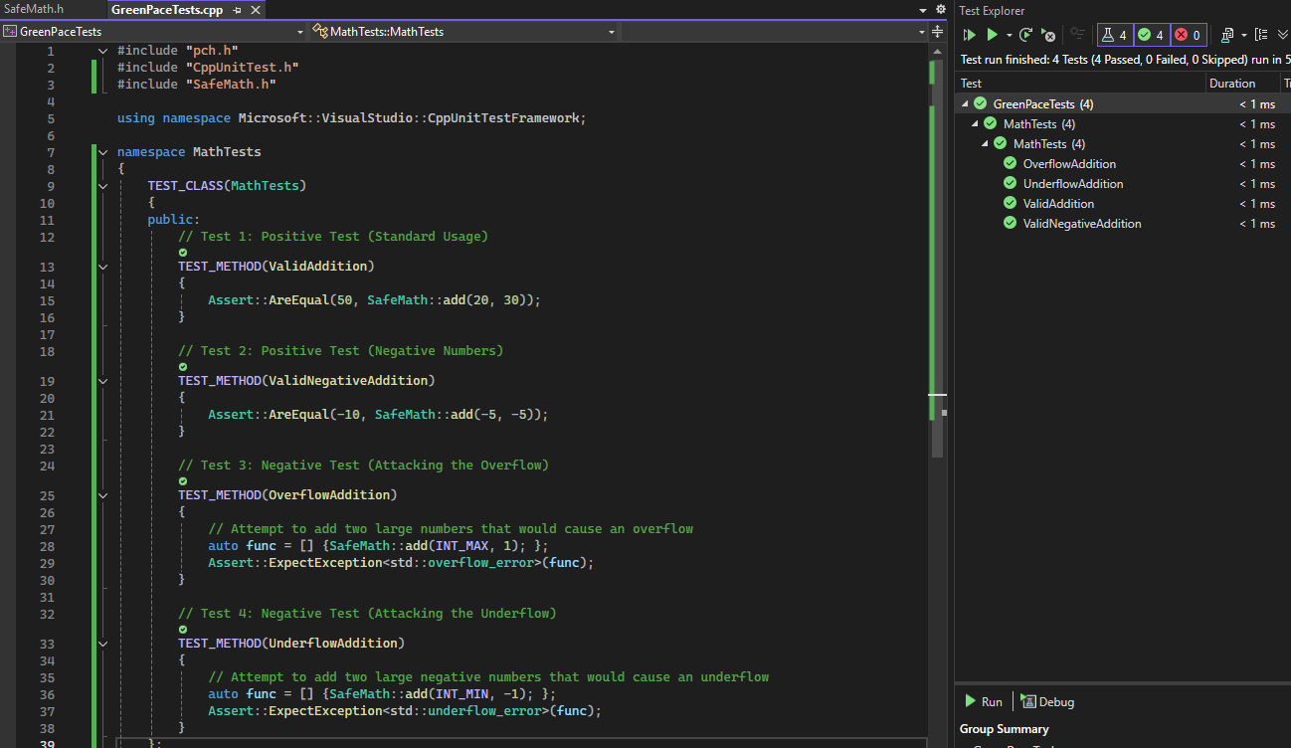
Does the system safely process valid integer addition?
Vulnerability Identified: Integer Overflow (INT30-C).
Test Type: Positive Test (Validates expected behavior).
Test Goal: Confirm that standard math (20 + 30) process correctly without triggering security exceptions.
Result: PASS. The system returned the expected value of 50.

Slide 9
Does the system safely process negative integer addition?
Vulnerability Identified: Integer Overflow (INT30-C).
Test Type: Positive Test (Verification of signed logic).
Test Goal: Confirm that the system correctly calculates the addition of negative integers (e.g., -5 + -5) without underflow or logic errors.
Result: PASS. The SafeMath logic confirmed the values were within the INT_MIN boundary and returned -10.

Slide 10
Does the system catch an Integer Overflow?
Vulnerability Identified: Integer Overflow (INT30-C).
Test Type: Negative Test (Vulnerability Simulation).
Test Goal: Confirm the system intercepts an attempt to add past the maximum integer limit (INT_MAX +1)
Result: PASS. The system successfully caught the overflow attempt and threw an overflow_error exception instead of wrapping around.

Slide 11
Does the system catch an Integer Underflow?
Vulnerability Identified: Integer Overflow (INT30-C).
Test Type: Negative Test (Vulnerability Simulation).
Test Goal: Confirm the system intercepts an attempt to subtract past the maximum integer limit (INT_MAX - 1)
Result: PASS. The system successfully caught the underflow attempt and threw an underflow_error exception.

Slide 12

AUTOMATION SUMMARY

Slide 13
TOOLS
DevSecOps Pipeline
Pre-Production (IDE & Build): Developers use local linters (e.g., Cppcheck) to catch syntax and memory errors (like INT30-C) before committing code.
Verify & Test (CI/CD Integration): Automated scanners (e.g., SonarQube) analyze pull requests for vulnerabilities like SQL injections and enforce coding standards.
Automated Gating: If a critical vulnerability is detected, the pipeline automatically blocks the build from merging into the main branch.
Monitor (Production): SIEM tools aggregate immutable logs for continuous auditing and threat detection.

Slide 14
RISKS AND BENEFITS of DevSpecOps
Problem & Solution: Manual security reviews are error-prone. Implementing automated DevSecOps catches vulnerabilities early.
Act Now vs. Wait: * Benefit of Acting Now: Drastically reduces technical debt and remediation costs.
Risk of Waiting: High probability of a data breach and failing the upcoming security audit.
Strategy Risks: Automated pipelines can generate false positives, leading to developer "alert fatigue".
Current Gaps: The strategy currently lacks third-party dependency scanning (Supply Chain Security).

Slide 15
RECOMMENDATIONS
Implement Supply Chain Security: Integrate Software Composition Analysis (SCA) tools to automatically scan third-party libraries and dependencies.
Continuous Developer Training: Establish mandatory, role-specific training on secure C++ coding standards to reduce errors and mitigate tool "alert fatigue."
Scheduled Penetration Testing: Contract an external red team bi-annually to actively test the DevSecOps pipeline and validate our defensive perimeter.
Standardize Secure Enclaves: Formalize a company-wide standard for using secure enclaves to protect all highly sensitive data "in use."

Slide 16
CONCLUSIONS
Institutionalize SEI CERT C++: Transition from "implicit" developer practices to a formal, mandatory adherence to established coding standards (e.g., INT, MEM, STR).
Maintain the DevSecOps Loop: Ensure the automated CI/CD pipeline remains the "source of truth" for security gates, preventing future vulnerability regressions.
Proactive Security Culture: Shift the company mindset from reactive patching to proactive, "Shift-Left" security engineering.
Audit Readiness: By adopting these standards today, Green Pace ensures 100% compliance for all future security and regulatory audits.

Slide 17
REFERENCES
Carnegie Mellon University. (n.d.). SEI CERT C++ coding standard. Software Engineering Institute. https://wiki.sei.cmu.edu/confluence/display/cplusplus
Microsoft. (2023). Unit testing C++ in Visual Studio. Microsoft Learn. https://learn.microsoft.com/en-us/visualstudio/test/unit-testing-cpp-with-visual-cpp
OWASP Foundation. (2021). OWASP Top 10:2021. https://owasp.org/www-project-top-ten/
Southern New Hampshire University. (2024). CS 405: Secure coding. Course Guidelines and Rubrics.
AI Disclosure: Generative AI (Gemini) was used during the creation of this presentation to assist with structuring slide content, formatting visual layouts, and refining draft speaker scripts. All core C++ code, unit testing, and security policy concepts represent my original work.

